Slide 1
Arduino Development for Beginners
Presented by Richard Gowen (@alt_bier)
V3 – Updated for BSidesDFW 2020 HHV
This Slide Deck Is Available at https://altbier.us/arduino/

Slide 2
WHAT IS ARDUINO?
Arduino is a tool for making computers that can sense and control more of the physical world than your desktop computer. It's an open-source physical computing platform based on a simple microcontroller board, and a development environment for writing software for the board.
Arduino can be used to develop interactive objects, taking inputs from a variety of switches or sensors, and controlling a variety of lights, motors, and other physical outputs.

Slide 3
Arduino Boards
Arduino boards come in many shapes and sizes to fit a wide variety of applications. Here is a list of just some of the Arduino boards available.
Arduino Uno
Arduino Leonardo
Arduino Due
Arduino Yun
Arduino Tre
Arduino Micro
Arduino Robot
Arduino Esplora
Arduino Mega ADK
Arduino Ethernet
Arduino Mega 2560
Arduino Mini
LilyPad Arduino USB
LilyPad Arduino Simple
LilyPad Arduino SimpleSnap
LilyPad Arduino
Arduino Nano
Arduino Pro Mini
Arduino Pro
Arduino Fio

Slide 4
Arduino Boards
Arduino Uno
Arduino Nano
Arduino Mega2560
Processor: ATmega328P Flash: 32 kB / SRAM: 2 kB Digital IO Pins: 14 / Analog Input Pins: 6 Dimensions: 2.7 in × 2.1 in
Processor: ATmega328 Flash: 16 kB / SRAM: 1 kB Digital IO Pins: 14 / Analog Input Pins: 8 Dimensions: 1.70 in × 0.73 in
Processor: ATmega2560 Flash: 256 kB / SRAM: 8 kB Digital IO Pins: 54 / Analog Input Pins: 18 Dimensions: 4 in × 2.1 in

Slide 5
Arduino Boards
Arduino Ethernet
Lilypad Arduino
Arduino Fio
Processor: ATmega328 Flash: 32 kB / SRAM: 2 kB Digital IO Pins: 14 / Analog Input Pins: 6 Built-in Ethernet Adapter instead of USB Dimensions: 2.7 in × 2.1 in
Processor: ATmega168V Flash: 16 kB / SRAM: 1 kB Digital IO Pins: 14 / Analog Input Pins: 8 Wearable Design Dimensions: 2 in Round
Processor: ATmega328P Flash: 32 kB / SRAM: 2 kB Digital IO Pins: 14 / Analog Input Pins: 8 Dimensions: 2.6 in × 1.1 in

Slide 6
Arduino IDE Software
The Arduino integrated development environment contains a text editor for writing code, a message area, a text console, a toolbar with buttons for common functions, and a series of menus. It connects to the Arduino hardware to upload programs and communicate with them.

Slide 7
Arduino IDE Software
You can download the Arduino IDE Software here: https://arduino.cc
Click on Software > Downloads which will present you with options based on your OS.
There are versions for Windows, Linux, and Mac OS.

Slide 8
Arduino IDE Software
Once you install the Arduino Software on your workstation simply choose the Arduino board that you wish to interface with and the processor type. It should auto detect the COM port on your workstation it is physically connected to, but if not you can manually select that as well.
At this point you can upload code to program the Arduino or interface with the Arduino’s console to view its output.

Slide 9
Arduino IDE Software
The Arduino Software comes with several example programs that can be used to get started quickly programming your Arduino
There are also several online resources you could use to download Arduino code that will allow you to program your Arduino to do a variety of things.

Slide 10
Electronics 101
The next few slides will provide a basic review of electronics.
A working knowledge of some basic electronics concepts is necessary when working with the Arduino or any other hardware development board.
A more detailed electronics overview is available here: https://altbier.us/electronics/

Slide 11
Electric Current Types
ELECTRONICS 101
There are two types of electric current types: Alternating Current (AC), and Direct Current (DC).
In AC, the direction electricity flows throughout the circuit is constantly reversing. The frequency rate of this reversal is measured in Hertz (reversals per second). So, when they say that the US power supply is 60 Hz, what they mean is that it is reversing 120 times per second (twice per cycle).
In DC, electricity flows in one direction between power and ground. In this arrangement there is always a positive source of voltage and ground (0V) source of voltage.
Generally, any modern electronic device with computational ability uses DC. The reason is that they use specific voltage levels to indicate binary/logical states.

Slide 12
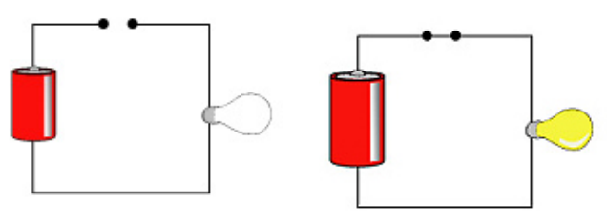
Open and Closed Circuits
ELECTRONICS 101
Electrons will not flow through an open circuit (left diagram)
Electrons will flow freely through a closed circuit (right diagram).
A switch is a device that allows for a circuit to be toggled between its open and closed states.

Slide 13
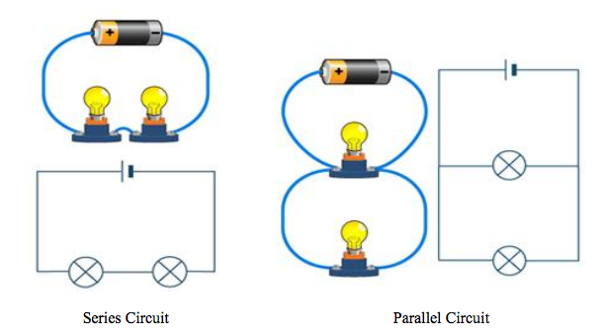
Parallel vs. Series Circuits
ELECTRONICS 101
In a series circuit, the current through each of the components is the same, and the voltage across the circuit is the sum of the voltages across each component.
In a parallel circuit, the voltage across each of the components is the same, and the total current is the sum of the currents through each component.

Slide 14
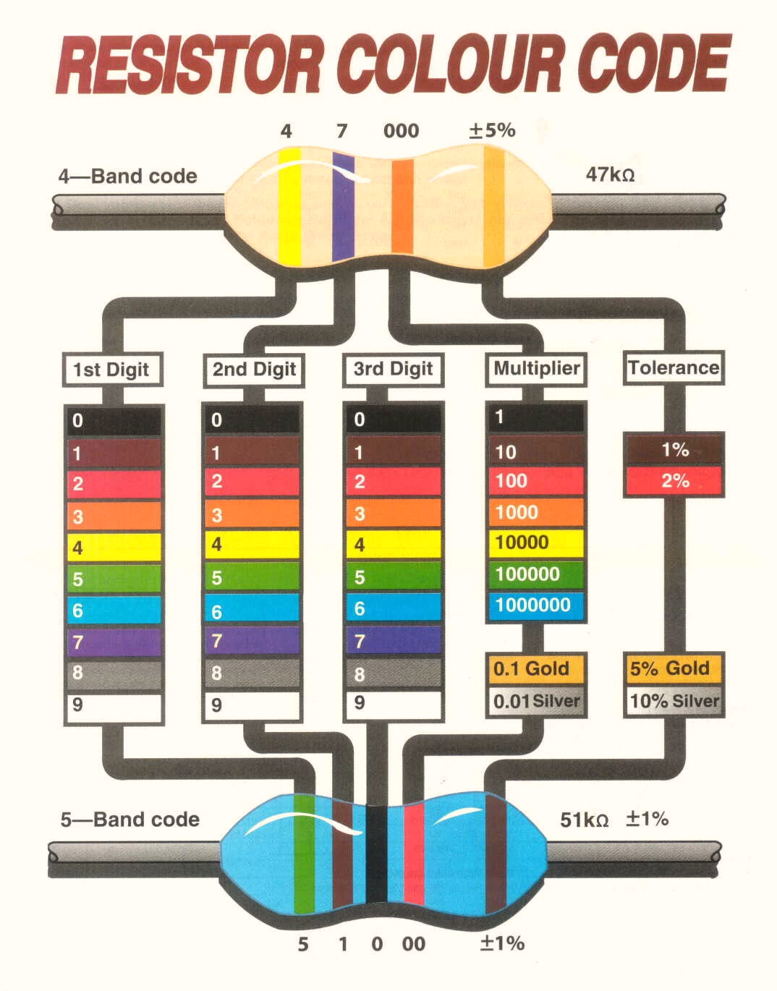
resistors
ELECTRONICS 101
A Resistor is a passive two-terminal electrical component that implements resistance as a circuit element.
Resistors may be used to reduce current flow, and, at the same time, may act to lower voltage levels within circuits.
The amount of resistance a resistor adds to a circuit as measured in ohms (Ω).
Resistors are non-polar components (i.e. can be placed in a circuit in either direction).
The resistance value is usually printed onto the component in the form of colored stripes. Some resistors have four stripes, and some have five.
The resistor color chart (right) can be used to determine the value.

Slide 15
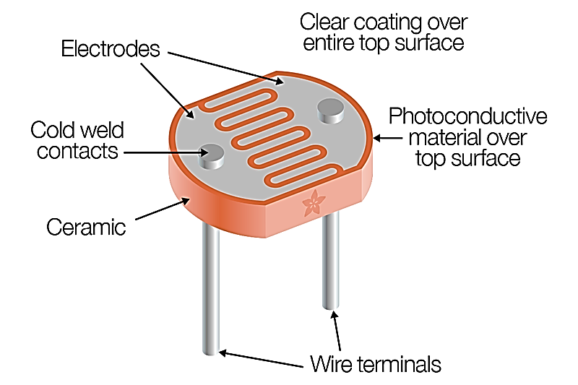
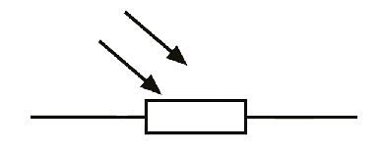
Photoresistors
ELECTRONICS 101
A Photoresistor also known as a Light Dependent Resistor (LDR) is a passive component that decreases resistance with respect to receiving luminosity (light) on the component's sensitive surface. The resistance of a photoresistor decreases with increase in light
Its resistance depends on the intensity of light incident upon it:
Under dark conditions, resistance is very high (M Ω).
Under bright condition, resistance is lowered (~100 - 200 Ω).
Photoresistors are non-polar components (i.e. can be placed in a circuit in either direction).
A photoresistor can be applied in light-sensitive detector circuits and light-activated and dark-activated switching circuits acting as a resistance semiconductor.

Slide 16
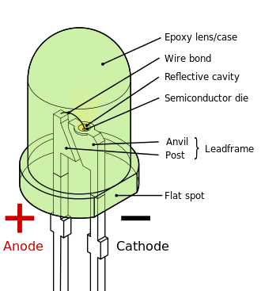
Diodes and Light Emitting Diodes
ELECTRONICS 101
A Diode is a two-terminal electronic component that conducts primarily in one direction; has low (ideally zero) resistance to current in one direction, and high (ideally infinite) resistance in the other.
This directionality indicates that diodes are polar components (i.e. must be placed in a circuit in the proper direction).
A diodes two electrodes are called Anode and Cathode.
The Anode is the positively charged electrode
The Cathode is the negatively charged electrode
A light-emitting diode (LED) emits light when activated.
When a suitable voltage is applied, electrons that pass through the device release energy in the form of photons. This effect is called electroluminescence, and the color of the light corresponds to the energy of the photons released.

Slide 17
Arduino Simple Projects
Two very simple Arduino projects are outlined in this section.
Making an LED Blink
Making an RGB LED Cycle through colors
These projects are Arduino introduction staples. They have been presented by many others and well documented on the Internet because they are so effective.
These will be outlined here as typically presented and then again in the intermediate project section that follows as we learn to do more with these same simple circuits.
Feel free to skip ahead to the intermediate project section where these projects will be outlined in a slightly different way.

Slide 18
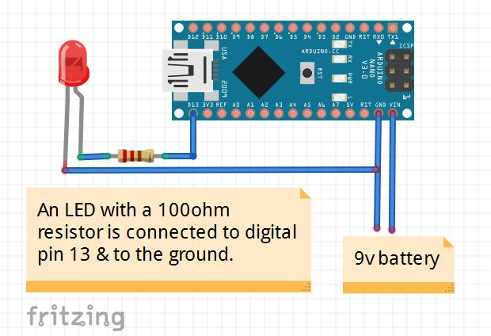
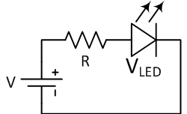
Arduino Nano Making One LED Blink
Things you will need:
Arduino Nano
A breadboard
An LED
A resistor 100 ohm
Jumper wires
Wiring:
You have to attach the LED to the Nano in a circuit as shown in the example image.
Connect the LED's positive end to the resistor and the negative end to the Nano’s ground. Connect the other end of the resistor to the Nano's digital pin 13 to complete a circuit.
To power the Nano board, you can use a USB cable or connect an external battery positive to VIN and negative to ground.

Slide 19
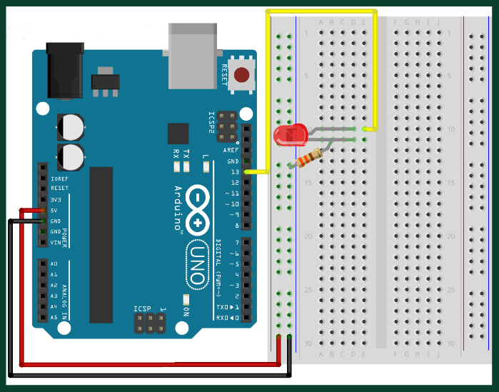
Arduino Uno Making One LED Blink
Things you will need:
Arduino Uno
A breadboard
An LED
A resistor 100 ohm
Jumper wires
Wiring:
You have to attach the LED to the Uno in a circuit as shown in the example image.
Connect the LED's positive end to the resistor and the negative end to the Uno’s ground. Connect the other end of the resistor to the Uno's digital pin 13 to complete a circuit.
To power the Uno board, you can use a USB cable or connect an external battery.

Slide 20
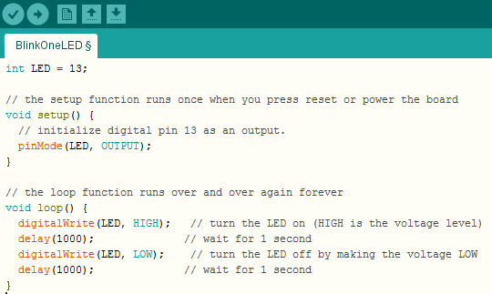
Arduino Making One LED Blink
Programming the Arduino (This code works for the Nano & Uno):
Connect the Arduino to your workstation via USB
The LED blink code should be in your Arduino IDE software examples.
Open the example blink code in File -> Examples -> Basics -> Blink
Upload this code to the Arduino by clicking on the upload button
You should see the LED start blinking on and off in 1 second intervals
This Code Is Available Here: https://altbier.us/arduino/BlinkOneLED.txt

Slide 21
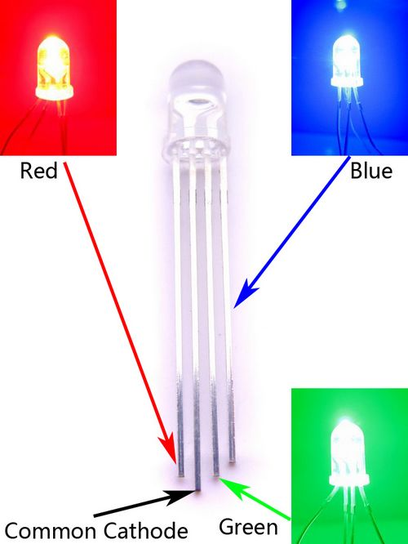
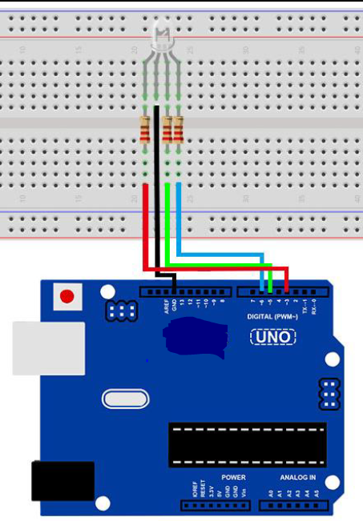
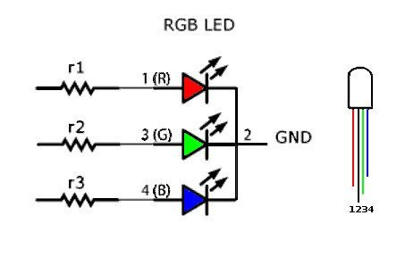
Arduino Uno Making An RGB LED Cycle
Things you will need:
Arduino Uno
A breadboard
An RGB LED
Three resistors 100 ohm
Jumper wires
Wiring:
You have to attach the LED to the Uno in a circuit as shown in the example image.
Connect the LED's positive ends to the resistors and the negative end to the Uno’s ground. Connect the other ends of the resistors to the Uno's digital pins 3, 5, and 6 as shown to complete a circuit.
To power the Uno board, you can use a USB cable or connect an external battery.

Slide 22
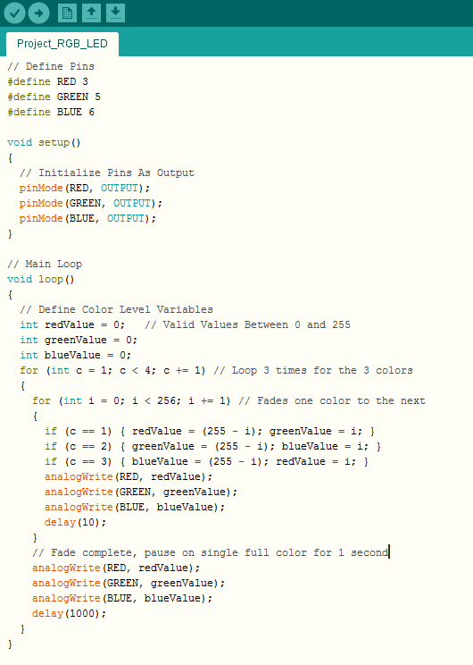
Arduino Uno Making An RGB LED Cycle
Programming the Arduino Uno:
Connect the Arduino Uno to your workstation via USB
Type in the example code (right) into your Arduino IDE software as a new project
Upload this code to the Arduino by clicking on the upload button
You should see the RGB LED start transitioning between colors pausing on red, green, and blue for one second before transitioning to the next color
This Code Is Available Here: https://altbier.us/arduino/RGB_LED.txt

Slide 23
Arduino Intermediate Projects
This next section will outline some intermediate Arduino projects.
These projects will be centered around three different physical circuit layouts with several Arduino code blocks for each.
LED connected to Arduino Nano PWM – Lab HHV2020_01
Digital Blink LED
Analog Fade LED
Analog Step LED
RGB LED and Tactile Switch connected to Arduino Nano – Lab HHV2020_02
Color Cycle RGB LED
Use Tactile Switch (Button) to Color Change RGB LED
LED and Photoresistor connected to Arduino Nano – Lab HHV2020_03
Use Light via a Photoresistor to Control LED state (on/off)
Use a Photoresistor to display Luminosity levels
The Lab reference numbers refer to the BSidesDFW Hardware Hacking Village Videos which can be accessed here: https://altbier.us/bsidesdfwHHV2020/

Slide 24
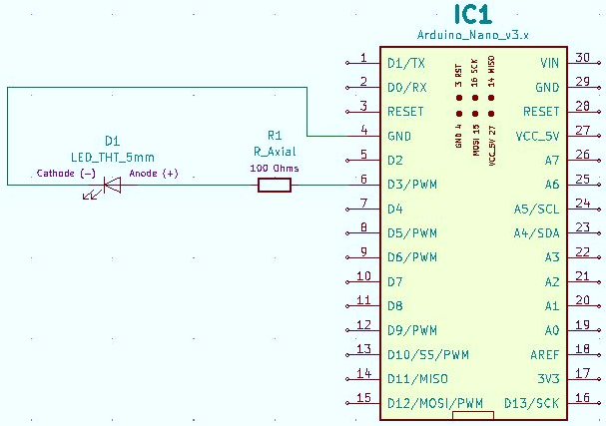
LED connected to Arduino Nano PWM
LAB HHV2020_01
Schematic
Wire up a circuit as shown in the schematic and physical layout.
Physical Layout
Strip Board Connection Details
Arduino Nano – I1-15 and K1-15
Resistor 100 Ohm – L10 and O10
LED – P10 (Anode) and Q10 (Cathode)
Wire – R10 and L12
Components:
1x Resistor 100 Ohm
1x LED 5mm

Slide 25
LED connected to Arduino Nano PWM
LAB HHV2020_01
Blink LED (digital) Code
Use “digitalWrite” to turn the LED on / off by setting the voltage to HIGH (1) / LOW (0).
Note that “#define LED1 3” is equivalent to “int LED1 3” that was used in the simple project example.
/* **************************
* Arduino Nano Single LED Blink
*
* Use digitalWrite to Blink an LED
*
* Written by @alt_bier
*
**************************
*/
// Define Pins
#define LED1 3
void setup() {
// Initialize LED Pins As Output
pinMode(LED1, OUTPUT);
}
// Main Loop
void loop() {
digitalWrite(LED1, HIGH); // turn the LED on
delay(2000); // wait for 2 seconds
digitalWrite(LED1, LOW); // turn the LED off
delay(2000); // wait for 2 seconds
}
This Code Is Available Here: https://github.com/gowenrw/BSidesDFW_2020_HHV/

Slide 26
LED connected to Arduino Nano PWM
LAB HHV2020_01
Fade LED (analog) Code
Use “analogWrite” to cycle the LED through all values between 0 (LOW) and 255 (HIGH) .
We can use these analog values because the digital pin the LED is connected to supports PWM (Pulse Width Modulation). Not all digital pins support PWM and those without would be limited to binary values 0 (LOW) and 1 (HIGH).
There is code that prints values to serial. Open the serial monitor with a rate of 38400 baud. You should see the LED values being displayed as they are set in real time.
/* **************************
* Arduino Nano Single LED with PWM Fade
*
* Control an LED connected to a Digital PWM (Pulse Width Modulation) Pin
* Use analogWrite to set LED values between 0 (LOW) and 255 (HIGH)
* Create a Fade effect by using all values 0-255 then 255-0
*
* Digital Pins without PWM use digitalWrite with values of 0 (LOW) or 1 (HIGH)
*
* Written by @alt_bier
* ************************** */
// Define Pins
#define LED1 3
void setup()
{
// Initialize LED Pins As Output
pinMode(LED1, OUTPUT);
// Set up serial output to console (baud)
Serial.begin(38400);
}
// Main Loop
void loop()
{
// Set Delay Time [in ms]
int DelayTime = 5;
// Fade LED LOW to HIGH
for(int i=0; i<255; i++){
// Set the LED value using analogWrite
// analogWrite is only usable on Analog pins or Digital PWM pins
analogWrite(LED1, i);
// Print current LED value to serial console for troubleshooting
Serial.print(" LED_VALUE=");
Serial.println(i);
// Pause the loop to display LED
delay(DelayTime);
}
// Fade LED HIGH to LOW
for(int i=255; i>0; i--){
// Set the LED value using analogWrite
analogWrite(LED1, i);
// Print current LED value
Serial.print(" LED_VALUE=");
Serial.println(i);
// Pause the loop to display LED
delay(DelayTime);
}
}
This Code Is Available Here: https://github.com/gowenrw/BSidesDFW_2020_HHV/

Slide 27
LED connected to Arduino Nano PWM
LAB HHV2020_01
/* **************************
* Arduino Nano Single LED with PWM Step
*
* Control an LED connected to a Digital PWM (Pulse Width Modulation) Pin
* Use analogWrite to set LED values between 0 (LOW) and 255 (HIGH)
* Step through a list of predefined values
*
* Digital Pins without PWM use digitalWrite with values of 0 (LOW) or 1 (HIGH)
*
* Written by @alt_bier
* ************************** */
// Define Pins
#define LED1 3
// Define Variables
int step = 0;
void setup()
{
// Initialize LED Pins As Output
pinMode(LED1, OUTPUT);
// Set up serial output to console (baud)
Serial.begin(38400);
}
// Main Loop
void loop()
{
// Set Delay Time [in ms]
int DelayTime = 100;
// Step Value Array
int StepValue[10] = {0, 50, 100, 150, 200, 255, 200, 150, 100, 50};
// Set the LED value using analogWrite using the step and StepValue variables
// analogWrite is only usable on Analog pins or Digital PWM pins
analogWrite(LED1, StepValue[step]);
// Print current LED value to serial console for troubleshooting
Serial.print(" LED_VALUE=");
Serial.println(StepValue[step]);
// Increment the Step Counter
step = step + 1;
if (step > 9) {
// Reset step counter if it exceeds the num of StepValue array elements
step = 0;
}
// Pause the loop keeping the LED lit with current values before resuming
delay(DelayTime);
}
Step LED (analog) Code
Use “analogWrite” to cycle the LED through a set of predefined values between 0 (LOW) and 255 (HIGH) .
Just like with the previous example, we can use these analog values because the digital pin the LED is connected to supports PWM (Pulse Width Modulation).
In this example we are using a set of predefined values rather than cycling through every possible value. Notice the LED light intensity changing and how these transitions are not as smooth as the fade code.
There is code that prints values to serial. Open the serial monitor with a rate of 38400 baud. You should see the LED values being displayed as they are set in real time.
This Code Is Available Here: https://github.com/gowenrw/BSidesDFW_2020_HHV/

Slide 28
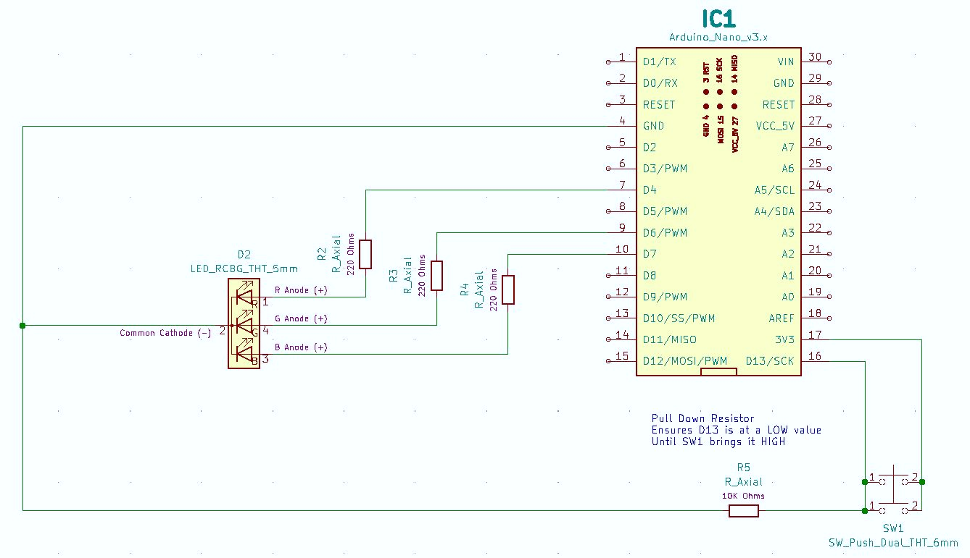
RGB LED and Tactile Switch on Arduino Nano
LAB HHV2020_02
Schematic

Slide 29
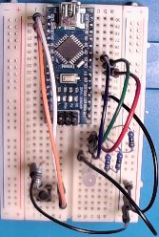
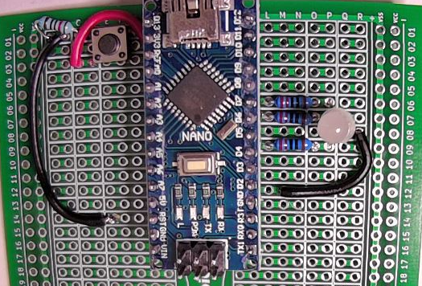
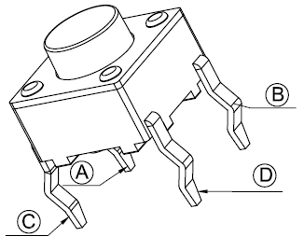
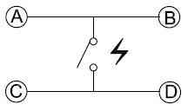
RGB LED and Tactile Switch on Arduino Nano
LAB HHV2020_02
Physical Layout
Wire up a circuit as shown in the schematic and physical layout.
Strip Board Connection Details
Arduino Nano – I1-15 and K1-15
Resistor 220 Ohm – L9 and O9
Resistor 220 Ohm – L7 and O7
Resistor 220 Ohm – L6 and O6
RGB LED
R Anode – P9
Cathode – Q8 (bend forward)
G Anode – P7
B Anode – P6
Wire – R8 and M12
Switch SPST 4 Pin
Pin A(1) – D1
Pin B(1) – G1
Pin C(2) – D3
Pin D(2) – N/C (bend off)
Resistor 10K Ohm – C1 and A1
Wire – H2 and C3
Wire – B1 and E14
Components:
3x Resistor 220 Ohm
1x Resistor 10K Ohm
1x RGB LED 5mm
1x Tactile Switch SPST 4pin

Slide 30
RGB LED and Tactile Switch on Arduino Nano
LAB HHV2020_02
RGB LED Cycle Code
Using an array of RGB color values we will cycle through the array of colors on the LED.
Open the serial monitor with a rate of 38400 baud to see the LED values being set.
// Main Loop
void loop()
{
// Set Delay for each transition of main loop [in ms]
int DelayTime = 100;
// Color Settings in R,G,B Binary Values
// 0 1 2 3 4 5 6
// White Red Yellow Green Cyan Blue Magenta
int Color[7][3] = {
{1, 1, 1}, {1, 0, 0}, {1, 1, 0}, {0, 1, 0}, {0, 1, 1}, {0, 0, 1}, {1, 0, 1}
};
// LED Pin Array
int LED[3] = {
LED2_RED, LED2_GREEN, LED2_BLUE
};
// Print to the serial console the current color selection for troubleshooting
Serial.print(" C=");
Serial.print(c);
for (int i = 0; i < 3; i++) { // Loop Through Each Color (MAX = 3 RGB)
// Send the digital value (1 or 0) to the LED PIN
digitalWrite(LED[i], Color[c][i]);
// Print to the serial console the pin and value sent for troubleshooting
Serial.print(" PIN=");
Serial.print(LED[i]);
Serial.print(" VALUE=");
Serial.print(Color[c][i]);
}
// Increment the Current Color
c = c + 1;
if (c > 6) {
c = 0;
}
// Print a new line to the serial console
Serial.println();
// Pause the loop keeping the LED lit with current values before resuming
delay(DelayTime);
}
/* **************************
* Arduino Nano RGB LED Cycle
*
* Cycle between predefined RGB color values
*
* Written by @alt_bier
* ************************** */
// Define Pins
#define LED2_RED 4
#define LED2_GREEN 6
#define LED2_BLUE 7
// Define Variables
int c = 0;
void setup()
{
// Initialize LED Pins As Output
pinMode(LED2_RED, OUTPUT);
pinMode(LED2_GREEN, OUTPUT);
pinMode(LED2_BLUE, OUTPUT);
// Set up serial output to console (baud)
Serial.begin(38400);
}
This Code Is Available Here: https://github.com/gowenrw/BSidesDFW_2020_HHV/

Slide 31
RGB LED and Tactile Switch on Arduino Nano
LAB HHV2020_02
// Main Loop
void loop()
{
// Set Delay for each transition of main loop [in ms]
int DelayTime = 100;
// Color Settings in R,G,B Binary Values
// 0 1 2 3 4 5 6
// White Red Yellow Green Cyan Blue Magenta
int Color[7][3] = {
{1, 1, 1}, {1, 0, 0}, {1, 1, 0}, {0, 1, 0}, {0, 1, 1}, {0, 0, 1}, {1, 0, 1}
};
// LED Pin Array
int LED[3] = {
LED2_RED, LED2_GREEN, LED2_BLUE
};
// Read the state of SW1
SW1State = digitalRead(SW1);
// Print to the serial console the state of SW1 for troubleshooting
Serial.print(" SW1=");
Serial.print(SW1State);
// Check if SW1 is pressed.
// If it is, the SW1State is HIGH:
if (SW1State == HIGH) {
// Increment the Current Color
c = c + 1;
if (c > 6) {
c = 0;
}
}
// Print to the serial console the current color selection for troubleshooting
Serial.print(" C=");
Serial.print(c);
for (int i = 0; i < 3; i++) { // Loop Through Each Color (MAX = 3 RGB)
// Send the digital value (1 or 0) to the LED PIN
digitalWrite(LED[i], Color[c][i]);
// Print to the serial console the pin and value sent for troubleshooting
Serial.print(" PIN=");
Serial.print(LED[i]);
Serial.print(" VALUE=");
Serial.print(Color[c][i]);
}
// Print a new line to the serial console
Serial.println();
// Pause the loop keeping the LED lit with current values before resuming
delay(DelayTime);
}
RGB LED with Tactile Switch Code
Using an array of RGB color values and a tactile switch we will cycle through the array of colors on the LED one at a time when the switch is pushed.
Open the serial monitor with a rate of 38400 baud to see the LED values being set.
/* **************************
* Arduino Nano RGB LED with Tactile Switch
*
* Control a Red Green Blue Common Cathode LED using a Tactile Switch
* Cycle between predefined RGB color settings by pressing the Tactile Switch
*
* Written by @alt_bier
* ************************** */
// Define Pins
#define LED2_RED 4
#define LED2_GREEN 6
#define LED2_BLUE 7
#define SW1 13
// Define Variables
int c = 0;
int SW1State = 0;
void setup()
{
// Initialize LED Pins As Output
pinMode(LED2_RED, OUTPUT);
pinMode(LED2_GREEN, OUTPUT);
pinMode(LED2_BLUE, OUTPUT);
// Initialize Tactile Switch Pin As Input:
pinMode(SW1, INPUT);
// Set up serial output to console (baud)
Serial.begin(38400);
}
This Code Is Available Here: https://github.com/gowenrw/BSidesDFW_2020_HHV/

Slide 32
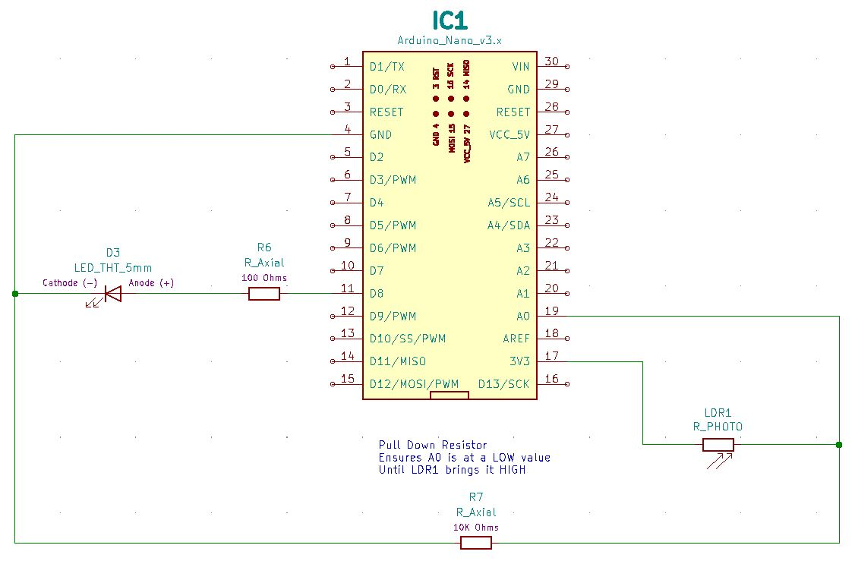
LED and Photoresistor connected to Arduino Nano
LAB HHV2020_03
Schematic

Slide 33
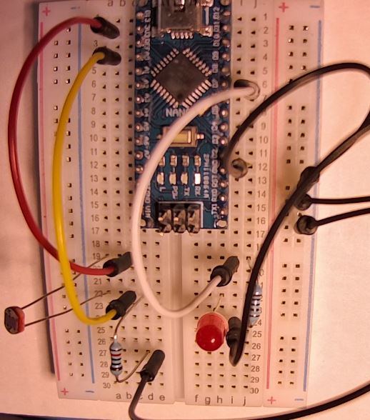
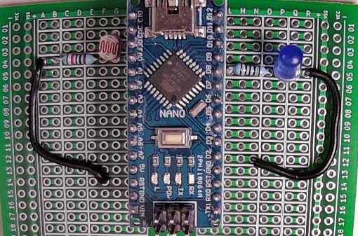
LED and Photoresistor connected to Arduino Nano
LAB HHV2020_03
Physical Layout
Wire up a circuit as shown in the schematic and physical layout.
Strip Board Connection Details
Arduino Nano – I1-15 and K1-15
Resistor 100 Ohm – L5 and O5
LED – P5 (Anode) and Q5 (Cathode)
Wire – R5 and N12
Photoresistor – G2 and G4
Resistor 10K Ohm – B4 and F4
Wire – A4 and F14
Note how the pull-down resistor is connected to ground on a different Arduino pin than the LED even though the schematic shows them using the same pin.
This is possible because the ground pins on the Arduino are interconnected.
Components:
1x Resistor 100 Ohm
1x Resistor 10K Ohm
1x LED 5mm
1x Photoresistor

Slide 34
LED and Photoresistor connected to Arduino Nano
LAB HHV2020_03
Photoresistor LED Control Code
Use a photoresistor to control an LED turning it on when it is dark and off when it is light.
Cover the photoresistor to produce dark values which will turn on the LED
Open the serial monitor with a rate of 38400 baud to see the photoresistor values being read and the LED values being set.
// Main Loop
void loop()
{
// Set Delay Time [in ms]
int DelayTime = 100;
// Set the Photoresistor Threshold
int pthr = 30;
// Record the Photoresistor Value
pval = analogRead(PR1);
// Print current Photoresistor Value to serial console for troubleshooting
Serial.print(" PVAL=");
Serial.print(pval);
// Set the LED value to HIGH (on) or LOW (off)
// based on Photoresistor Value and Threshold
if (pval > pthr) {
// Turn LED OFF
digitalWrite(LED3, LOW);
// Print current LED state to serial console for troubleshooting
Serial.print(" LED OFF");
} else {
// Turn LED ON
digitalWrite(LED3, HIGH);
// Print current LED state to serial console for troubleshooting
Serial.print(" LED ON");
}
// Print a new line to the serial console
Serial.println();
// Pause the loop keeping the LED lit with current values before resuming
delay(DelayTime);
}
/* **************************
* Arduino Nano Photoresistor LED Control
*
* Use the input from a Photoresistor to control an LED
* The Photoresistor will provide analog values indicating dark or light
* Set an LED to on (HIGH) or off (LOW) based on dark or light values
*
* Written by @alt_bier
* ************************** */
// Define Pins
#define LED3 8
#define PR1 A0
// Define Variables
int pval;
void setup()
{
// Initialize LED Pins As Output
pinMode(LED3, OUTPUT);
// Initialize Photoresistor Pin As Input:
pinMode(PR1, INPUT);
// Set up serial output to console (baud)
Serial.begin(38400);
}
This Code Is Available Here: https://github.com/gowenrw/BSidesDFW_2020_HHV/

Slide 35
LED and Photoresistor connected to Arduino Nano
LAB HHV2020_03
void setup()
{
// Initialize LED Pins As Output
pinMode(LED3, OUTPUT);
// Initialize Photoresistor Pin As Input:
pinMode(PR1, INPUT);
// Set up serial output to console (baud)
Serial.begin(38400);
}
// Main Loop
void loop()
{
// Set Delay Time [in ms]
int DelayTime = 100;
// Set the Photoresistor Threshold
int pthr = 30;
// Record the Photoresistor Value
pval = analogRead(PR1);
// Print current Photoresistor RAW Value to serial console for troubleshooting
Serial.print(" PVAL=");
Serial.print(pval);
Serial.print(" raw ");
// Get the lumens based on pval
lux = sensorRawToPhys(pval);
// Print the Light Level
Serial.print(" Light=");
Serial.print(lux);
Serial.print(" lumen ");
// Set the LED value to HIGH (on) or LOW (off)
// based on Photoresistor Value and Threshold
if (pval > pthr) {
// Turn LED OFF
digitalWrite(LED3, LOW);
// Print current LED state to serial console for troubleshooting
Serial.print(" LED OFF");
} else {
// Turn LED ON
digitalWrite(LED3, HIGH);
// Print current LED state to serial console for troubleshooting
Serial.print(" LED ON");
}
// Print a new line to the serial console
Serial.println();
// Pause the loop keeping the LED lit with current values before resuming
delay(DelayTime);
}
Photoresistor Luminosity Code
Use a photoresistor to display the luminosity of its environment measured in lumens.
Cover the photoresistor to produce dark values which will show the decrease in luminosity.
Open the serial monitor with a rate of 38400 baud to see the photoresistor values in raw analog form and converted lumens.
/* **************************
* Arduino Nano Photoresistor Luminosity
*
* Use the input from a Photoresistor to measure
* the amount of light a.k.a. luminosity (Lux)
* in lumens it is receiving in real time
*
* Written by @alt_bier
* ************************** */
// Define Pins
#define LED3 8
#define PR1 A0
// Define Constants
#define VIN 3.3 // V power voltage
#define R7 10000 // Pull down resistor ohm value
// Define Variables
int pval;
float lux;
// Variable converts raw analog value to physical light value (lumen)
float sensorRawToPhys(int raw){
// Conversion rule
float Vout = float(raw) * (VIN / float(1023)); // Conversion analog to voltage
float RLDR = (R7 * (VIN - Vout))/Vout; // Conversion voltage to resistance
float phys=500/(RLDR/1000); // Conversion resistance to lumen
return phys;
}
This Code Is Available Here: https://github.com/gowenrw/BSidesDFW_2020_HHV/

Slide 36
Thank You
I hope you enjoyed this presentation and learned something from it.
-- @alt_bier
This Slide Deck – https://altbier.us/arduino/
Code – https://github.com/gowenrw/BSidesDFW_2020_HHV/

